Slide 1
Simulating Contact Tracing in the Pandemic: TTI Explorer
Andrei Paleyes and Bryn Elesedy

Slide 2
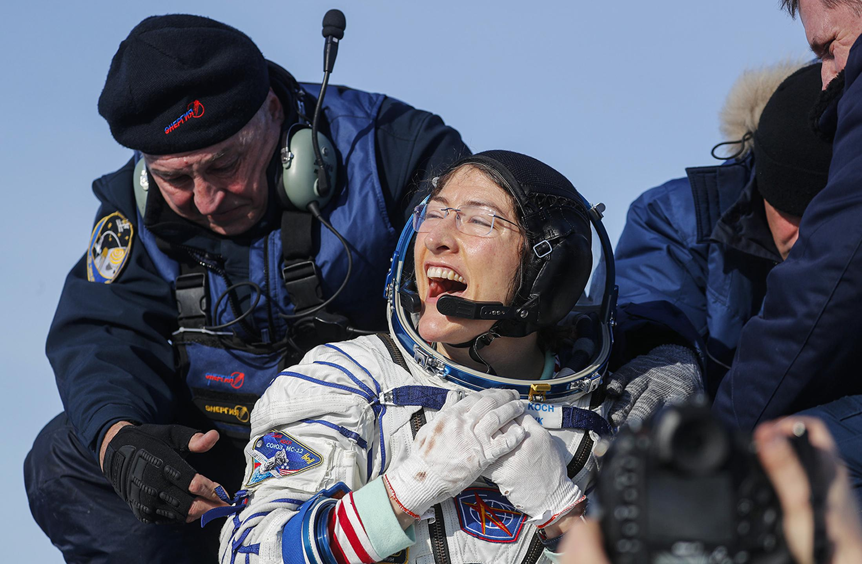
COVID-19
Does it really need an introduction?

Slide 3
What to do about COVID?
Would be great if we had a vaccine, but we don’t.
Need non-pharmaceutical interventions (NPIs) in their place to prevent transmission. E.g. masks, social distancing, lockdowns.
Test, Trace, Isolate (TTI) is one such NPI

Slide 4
What is TTI?
Test people for disease
Trace their contacts
Isolate people
Many believe it is an effective tool to:
Reduce transmission =>
Smaller R =>
Fewer cases
Kucharski, Adam J., et al. "Effectiveness of isolation, testing, contact tracing and physical distancing on reducing transmission of SARS-CoV-2 in different settings." medRxiv (2020).

Slide 5
TTI: a silver bullet!
Boris Johnson
May 10, 2020
And if we are to control this virus, then we must have a world-beating system for testing potential victims, and for tracing their contacts.

Slide 6
Is it really a silver bullet?
How effective can it be?
What are resource requirements?
Number of tests needed
Application uptake
Manual tracing
What are the most important success factors?

Slide 7
DELVE

Slide 8
DELVE
Data Evaluation and Learning for Viral Epidemics
Cross-disciplinary group
Convened by the Royal Society in March 2020
Feeds into SAGE
Publishes reports and other artifacts for general public
https://rs-delve.github.io

Slide 9
DELVE Test, Trace, Isolate report
Released: May 27, 2020
Covers compliance, surveillance, capacity constraints, public perception, etc.
Coverage: BBC, Channel 4, Financial Times, The Independent, The Times, The Guardian, Daily Mail, New Scientist
[Presumably] Influenced the overall policy

Slide 10
TTI Explorer

Slide 11
TTI Explorer: background
Explores the effectiveness and resource requirements of TTI strategies
Builds upon Kucharski et al. 2020
Takes into account logistics of real-world TTI
BBC Pandemic data for contacts

Slide 12
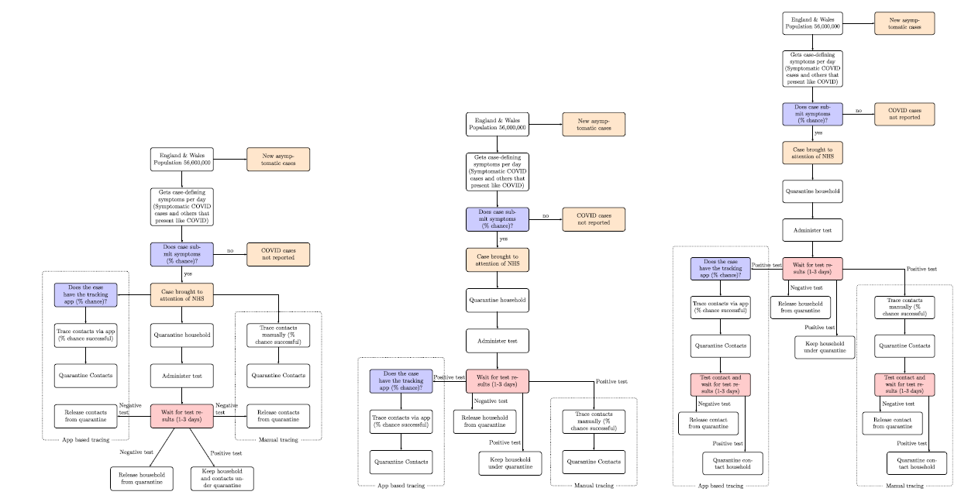
TTI flowchart

Slide 13
TTI Explorer: generate data
Generate primary cases
Has COVID, has symptoms
Has COVID, no symptoms
No COVID, has symptoms
Generate contacts
Household
Work/school
Other

Slide 14
TTI Explorer: simulation
5 levels of governmental measures (NPIs), S5 ≈ strict lockdown, S1 ≈ no control
4 TTI strategies
No TTI (baseline)
Trace on symptoms
Trace on positive test
Trace on positive test, test contacts
Account for
Quarantine
App and manual tracing
Compliance

Slide 15
TTI Explorer: key results
TTI alone is not enough, other NPIs are needed
Prompt self-isolation is very effective
Key success factors:
Test and (manual) trace times
Compliance with guidance

Slide 16
TTI Explorer: key results
Resources:
Manual tracing is essential to make up for low app installs
Symptom-based TTI is very expensive
Testing contacts doesn't impact R much, but reduces days in quarantine

Slide 17
Sensitivity Analysis
Notes:
Give intro of me
I’m going to talk to you about sensitivity analysis and how we used it in our TTI work...

Slide 18
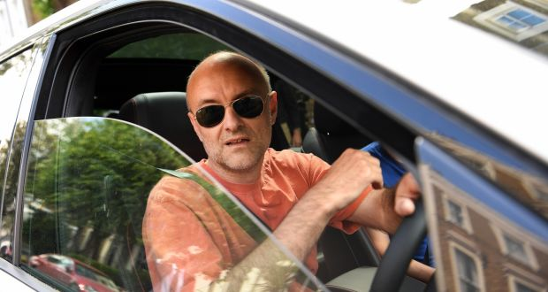

Why?
Two reasons we used sensitivity analysis:
Verify robustness to modelling assumptions
Example: What happens if we change our estimate of the proportion of asymptomatic positive cases?
Identify pinch points in TTI strategies and the magnitude of their effects
Example: How important is public compliance to the effectiveness of a TTI strategy?
Notes:
Two reasons we use SA. The reasons are...
Why are these things important?
Robustness: in principle, policy decisions might depend on results. Don’t want to make mistakes due to uncertainty.
Pinch points: What does Govt need to get right and why?

Slide 19
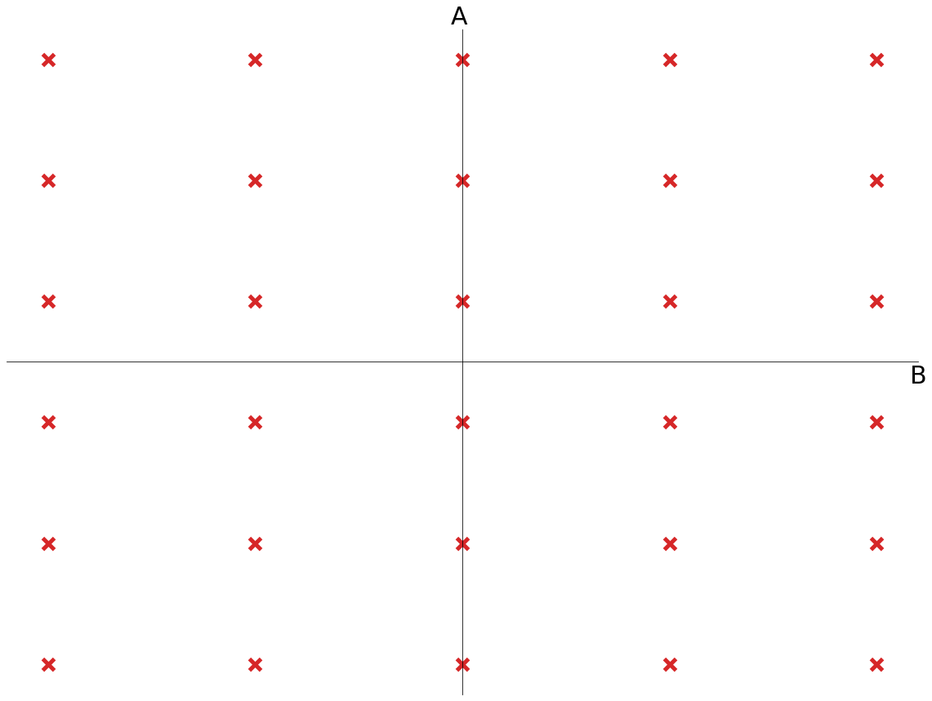
How?
Params of interest assigned to one of two very simple strategies
Grid Variation
Try all the combinations of all the parameters in this group
Axis Variation
Keep n-1 fixed at a default value, vary one at a time.
Measure e.g. reproduction number in each configuration
Notes:
Two simple strategies. Other options exist as I’m sure you know by now, but we took the easy way out.
Explain how they work
Details:
Define gridstep + bounds or values ahead of time
Note that some of the variables are not numerical, eg infectiousness over time
We assigned some parameters to 1 and some to 2, but mostly to 2 which doesn’t account for interactions.

Slide 20
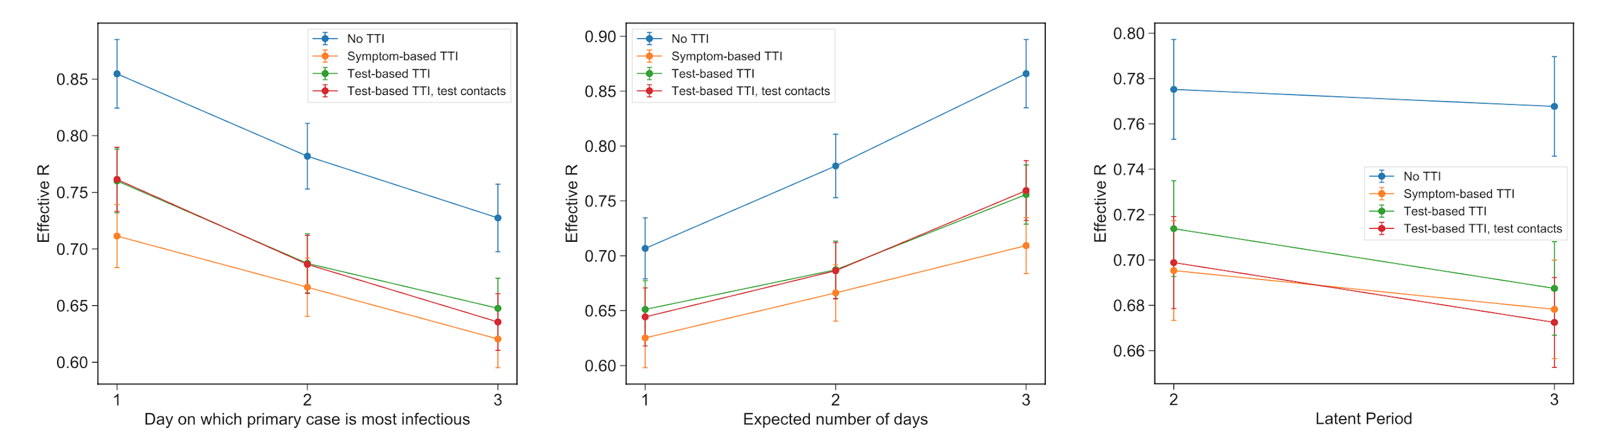
Results: Uncertainty
Notes:
Effect on R of varying some parameters of the disease for S5 (most severe) full-lockdown scenario.
Other S-levels look similar but with different Rs since more contacts and transmission.
What are the results:
Which day most infectious
Time until primary case gets symptoms
Length of latent period (time from _infected_ to _infectious_)
Results are sensible (left to right) and also model is relatively robust as shown by error bars.
TTI can catch ppl easier if they are more infectious later
The earlier ppl report symptoms, the easier it is to stop them from infecting others
Longer latent period gives TTI more time to find infected contacts before they infect others
Also considered factors such as #symptomatic covid negative individuals, eg with flu. Naturally, this increases number of tests needed.

Slide 21
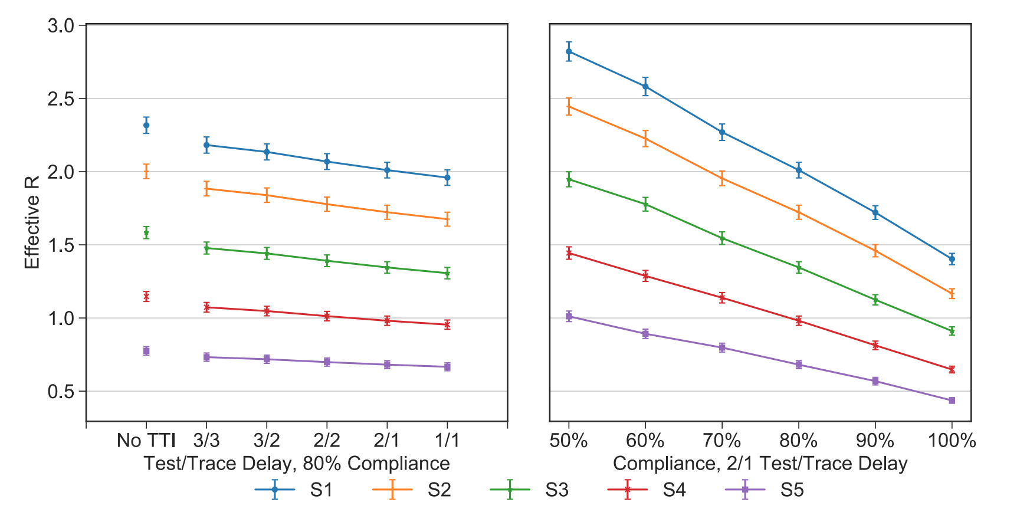
Results: Pinch Points
Notes:
Axis variation again
Impact of test/trace delay and compliance on R
Clear that each of these, especially compliance, are very important
Bear in mind number of cases and hence deaths is exponential in R
Note that compliance has strongest effect in weakest lockdown scenario, this is because ppl have more contacts so infect more people who will need to isolate

Slide 22
Extensions

Slide 23
Some ideas
Parameter interactions in sensitivity analysis
Inference: use the simulation “backwards”
More ideas relevant to this course in Appendix
Notes:
Brief explain

Slide 24
Parameter Interactions
In our sensitivity analysis, in particular when analysing pinch points such as public compliance, we did not study parameter interactions.
An extension could incorporate parameter interactions, possibly using one of the methods from your lectures.
Notes:
explain

Slide 25
Inference
Current simulation:
Parameters ⇒ # of new cases, R
Can you do this in reverse?
Real world R and cases ⇒ parameters (e.g. public compliance)
Notes:
Explain and chat

Slide 26
Using TTI Explorer Code
The technical report can be found here
All of our code is on GitHub at rs-delve/tti_explorer. Feel free to fork or contribute!
We made an introductory colab notebook to show how to use the code.
Notes:
explain

Slide 27
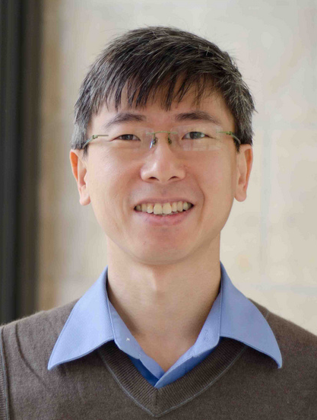


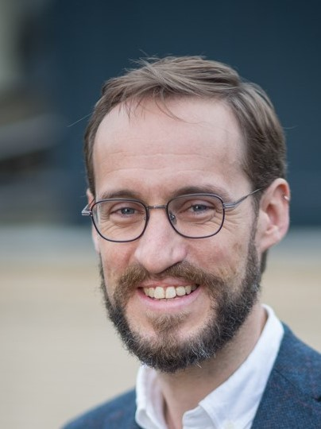
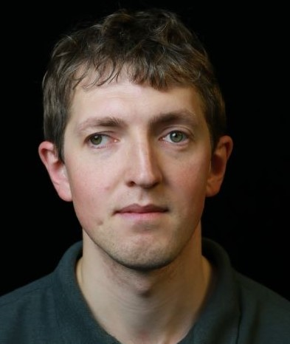



Team behind TTI Explorer (in no particular order)
Yee Whye Teh
Bryn Elesedy
Anne Johnson
Guy Harling
Andrei Paleyes
Michael Hutchinson
Bobby He
Sheheryar Zaidi
Notes:
Here are great collaborators

Slide 28
The End
Questions?
Notes:
Thanks for listening, what questions do you have.?... put questions in chat.

Slide 29
Appendix

Slide 30
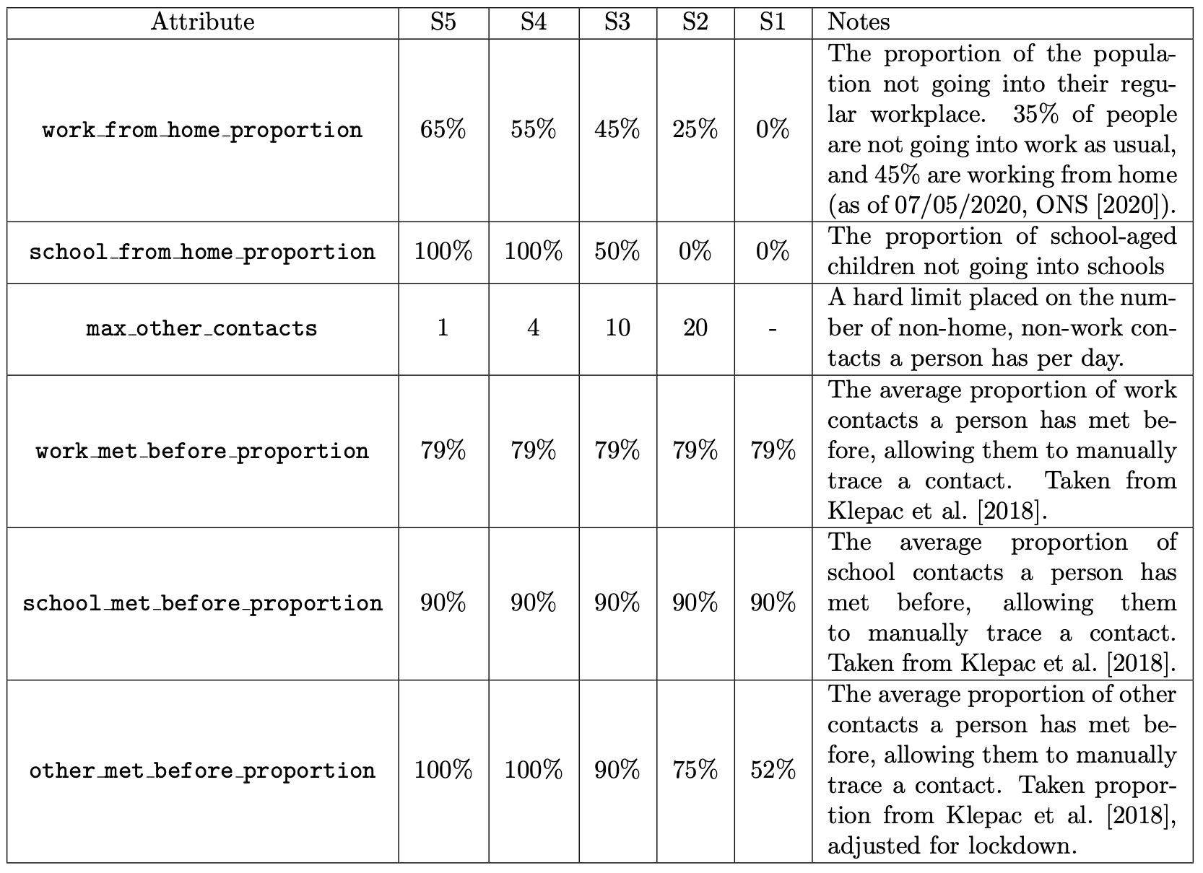
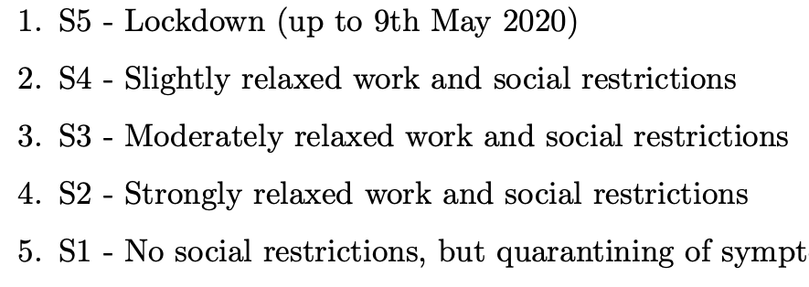
NPI Severity Levels

Slide 31
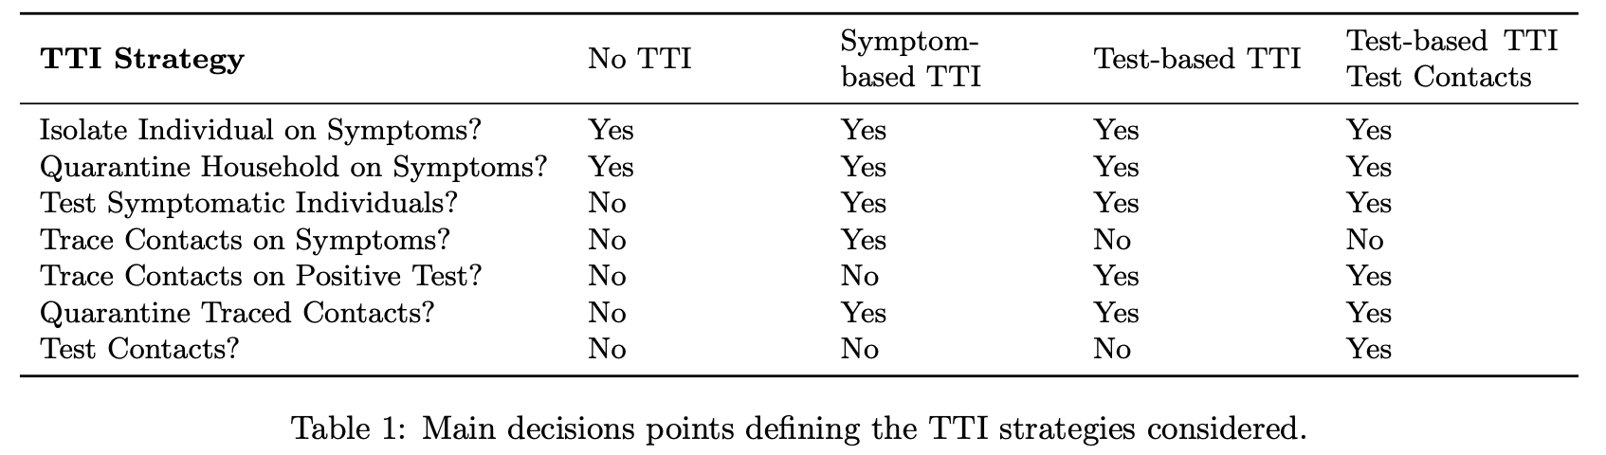
TTI Strategies Considered

Slide 32
Extension: Constrained BayesOpt
Can our model be used to find a strategy that results in the minimum possible reproduction number given a particular set of resource constraints (e.g. limited number of tests)?

Slide 33
Extension: Further Analysis
Consider the variation in the effective reproduction number (R), in the context of various levels of NPI stringency (i.e. various levels of lockdown), as we vary the uptake of a contact tracing app. (Figure 10, page 22 of report here.)
Why is R not monotonic in the level of app uptake in the more stringent lockdown scenarios?
Can you see anything else in our report that you think warrants further analysis?

Slide 34
Extension: Uncertainty Propagation
Many of the parameters of our model reflect properties of the disease or its dynamics about which we are uncertain, for instance: if you are infectious, how likely are you to infect someone in your household? How does your infectiousness change over time?
We attempted to quantify this uncertainty by measuring the variation in the outputs of our model as we vary these parameters. Can you do better? For instance, you might like to represent uncertainty in these parameters in terms of probability distributions, then propagate this uncertainty into a distribution over the outputs of the model.

Slide 35
Extension: Generative Model for Social Contacts
In our model we need, for each primary case, a number of social contacts of different types (eg people from home, work, school) who they have the potential to infect.
We used a very simple generate these contacts. The data from the BBC Pandemic Survey [1] contains data on the social contacts of 40162 participants. In short, each time we generate a primary case, we generate their social contacts by sampling a participant from this dataset and using their contact pattern.
Can you do better, for instance by constructing a generative model? Can you incorporate network effects?
1: Petra Klepac, Stephen Kissler, and Julia Gog. Contagion! The BBC Four Pandemic - The model behind the documentary. Epidemics, 24:49–59, March 2018. link.

